Slide 1
MCSD Certification Toolkit
Chapter 7 Lesson 1 – Multithreading and Asynchronous Operations

Slide 2
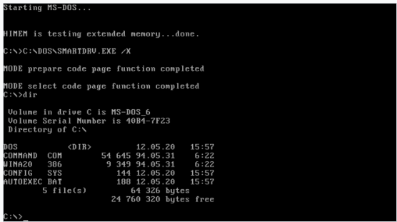
The ‘Good Ol’ Days’
The DOS operating system would run one program at a time. If you needed to run another program, you needed another computer.

Slide 3
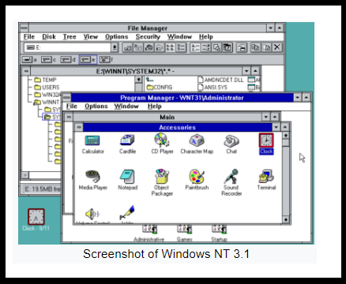
Windows
Windows (and previously OS/2) allowed the user to run multiple programs simultaneously.

Slide 4
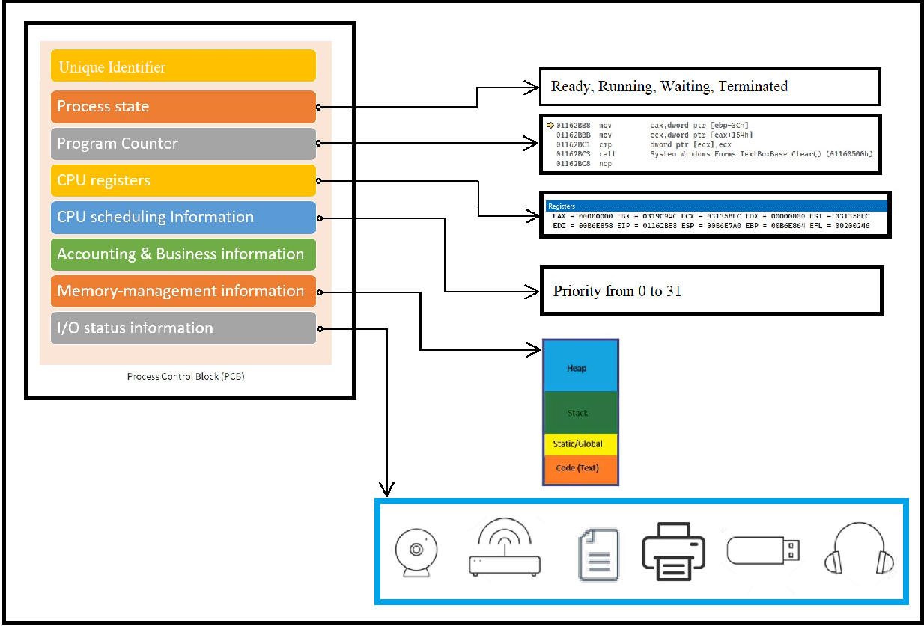
The Process Control Block (PCB)

Slide 5
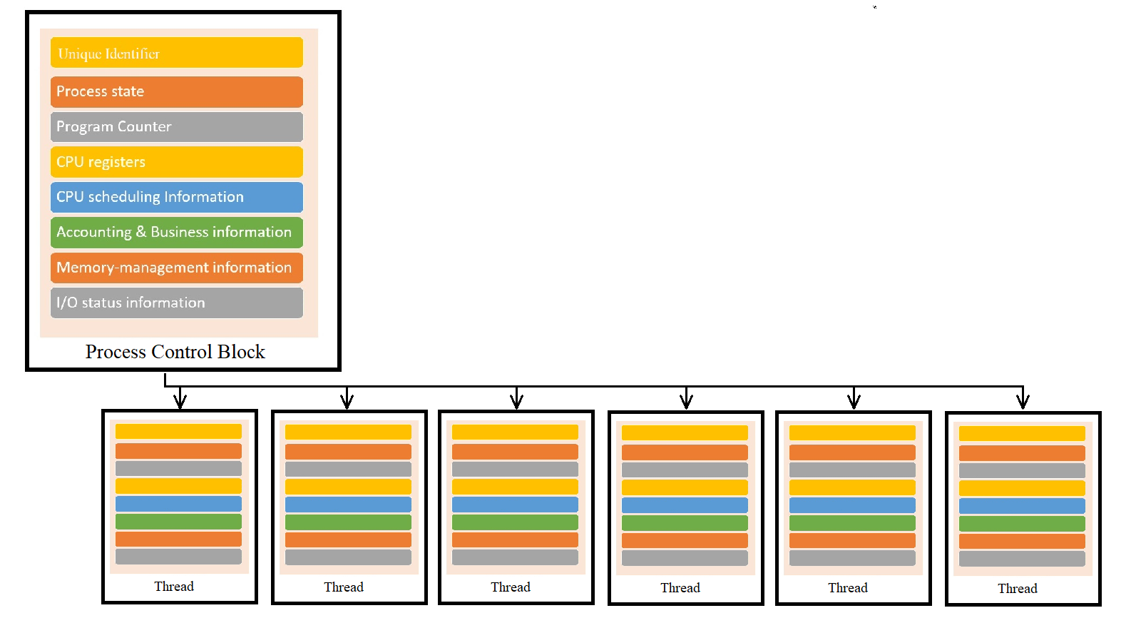
Threads – Children of the Process

Slide 6
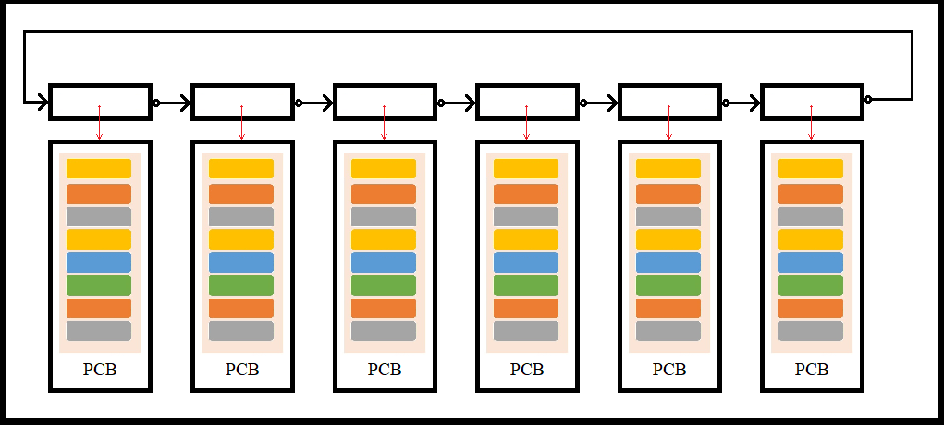
Context Switching
Saving the currently running process information and loading the next in priority order is referred to as context switching.
Saving the process information could mean saving the memory the process is using to disk.
Each process is allotted a time slot of 1/100th of a second before a context switch occurs.
Gives the appearance of simultaneous execution, but since there was only 1 CPU, no two processes could run simultaneously.
Quite possible to spend more time switching between contexts than executing a process.

Slide 7
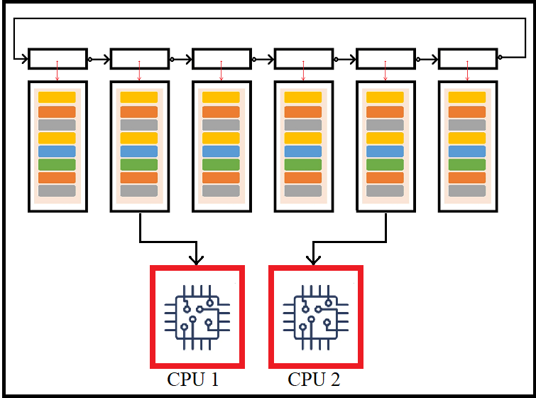
Multiple Processors
In 2005, both AMD and Intel introduced dual-core processors
This allowed for truly simultaneous processing capability

Slide 8
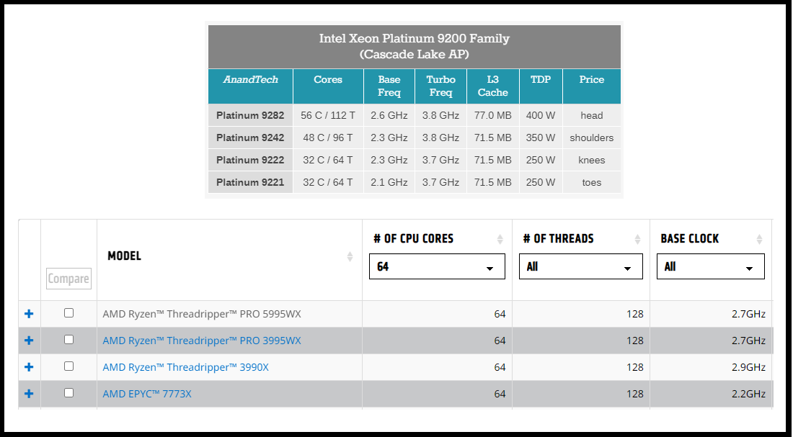
Current Technology (2022)

Slide 9
Threading in C#
Every C# GUI application has at least 4 threads
Main Thread
GUI Thread
Finalizer Thread
Garbage Collection Thread
All the above threads are ‘background’ threads except for the ‘Main’ thread. All background threads are terminated when the Main thread terminates.

Slide 10
Disadvantages of Threads
Takes a lot of memory to create a thread
If a program has a lot of threads, the time spent context switching could slow the program down.
It takes considerable amount of time to launch a thread as well as to destroy it.

Slide 11
Disadvantages of ThreadPool Threads
Always a background thread
Can’t abort or interrupt a ThreadPool thread
Can’t ‘join’ a ThreadPool thread
Can’t control priority of a ThreadPool thread

